Slide 1

Lecture 8
Systems Management

Slide 2

A G E N D A
What is Systems Management?
Role & Purpose of Systems Management
Why is Systems Management important?
Challenge of System Management
Best practices of effective System Management

Slide 3
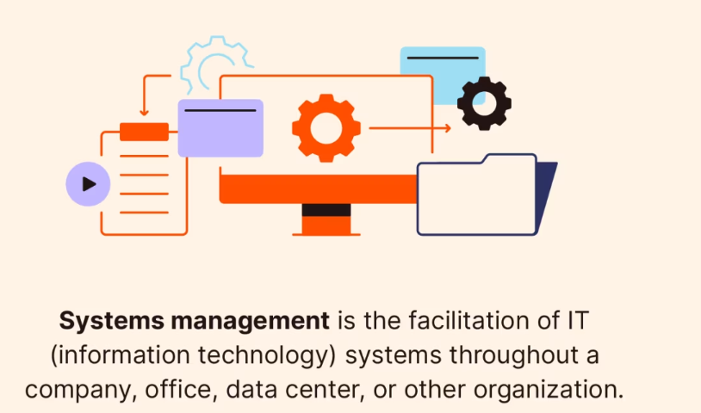
What is Systems Management?
Systems Management refers to the enterprise-wide administration of IT systems, including hardware, software, and networks. It encompasses a broad set of processes and tools designed to ensure that all technological systems within an organization operate efficiently, securely, and in alignment with its strategic objectives. Systems management involves monitoring system performance, managing assets, ensuring security and compliance, automating operations, and troubleshooting issues to minimize downtime and optimize performance.

Slide 4
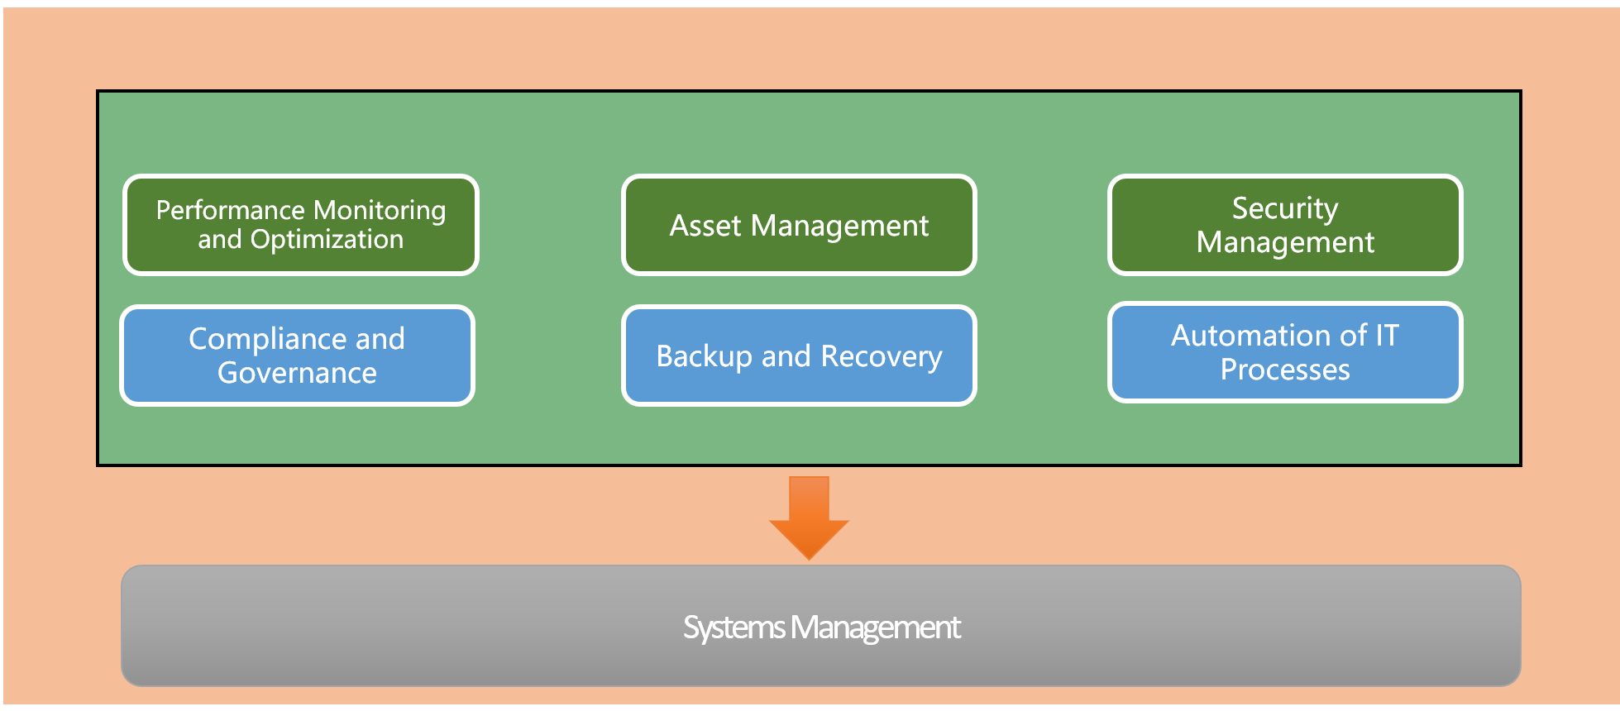
Role and Purpose of Systems
Performance Monitoring and Optimization: Regularly monitoring the performance of IT systems to identify and resolve issues promptly, ensuring optimal performance and availability.
Asset Management: Keeping track of all IT assets, including hardware and software inventory, to manage the lifecycle of these assets effectively.
Security Management: Implementing and maintaining security measures to protect data and IT systems from unauthorized access, breaches, and other cyber threats.

Slide 5
Role and Purpose of Systems
Compliance and Governance: Ensuring IT systems and practices comply with relevant laws, regulations, and internal policies.
Backup and Recovery: Managing data backup processes and disaster recovery plans to ensure data integrity and availability in case of system failure or data loss.
Automation of IT Processes: Automating routine tasks to improve efficiency, reduce manual errors, and free up IT staff for more strategic initiatives.

Slide 6
Why is Systems Management important?
Operational Efficiency: Effective systems management practices lead to higher operational efficiency by automating routine tasks and optimizing system performance.
Business Continuity: Ensuring that IT systems are reliable and available supports business continuity, minimizing the impact of IT issues on business operations.
Data Security: Robust systems management is essential for protecting sensitive data against cyber threats, reducing the risk of data breaches and their associated costs.
Regulatory Compliance: Helps organizations comply with increasingly complex regulatory requirements related to data protection, privacy, and IT governance.
Strategic Alignment: Aligns IT operations with business strategies, ensuring that technology supports and enhances business goals rather than hindering them.

Slide 7

Challenges of Systems Management

Slide 8
Challenges of Systems Management
Complexity: Managing modern IT environments can be complex due to the diversity of technologies, platforms, and devices.
Scalability: As organizations grow, scaling systems management processes and tools to accommodate increased demand can be challenging.
Security Threats: The evolving landscape of cyber threats requires continuous vigilance and adaptation of security practices.
Integration: Ensuring seamless integration between different systems, tools, and processes is often difficult but essential for efficient management.
Skill Gaps: The rapidly changing technology landscape can lead to skill gaps, requiring ongoing training and development for IT staff.

Slide 9
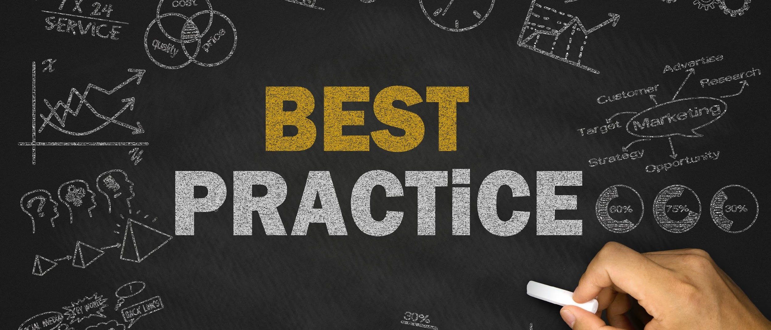
Best Practice for Effective Systems Management

Slide 10
Best Practice for Effective Systems Management
Implement Comprehensive Monitoring: Deploy comprehensive monitoring tools to gain visibility into system performance, security threats, and operational issues.
Adopt Automation: Leverage automation to streamline IT processes, reduce manual errors, and increase efficiency.
Regularly Review and Update Policies: Review and update systems management policies and procedures to adapt to changing business needs and technology landscapes.
Invest in Training: Continuously invest in training and development programs to keep IT staff updated with the latest technologies and best practices.
Choose Scalable Solutions: Opt for scalable systems management solutions that can grow with the organization and adapt to future needs.

